Slide 1



Slide 2



 | Slope Bins 4 | Smear Count 25
Block number | Alpha w/ Henderson Hasselbalch | Chi Chi_max = 2.2
[0 50] | 0.040012 | 1.160000
[50 75] | -0.278451 | 0.720000
[75 125] | -0.519707 | 0.608000
[125 156] | -0.154453 | 0.529032

Slide 3


 | Slope Bins 4 | Smear Count 31
Block number | Alpha w/ Henderson Hasselbalch | Chi Chi_max = 2.2
[0 31] | 0.001103 | 0.922581
[31 62] | -0.386873 | 0.703226
[62 93] | -0.290146 | 0.967742
[93 496] | 0.037164 | 1.098759
[496 527] | -0.064533 | 0.819355
[527 620] | 0.010682 | 0.756989
[620 647] | -0.103326 | 0.696296

Slide 4
Binary results

Slide 5







For i as L and H:
Pure height profiles
Mixed height profiles
Current L library
Current H library
Skip; marginal increase in vol prob not enough
Move onto chi3.0; larger NFL vol library

Slide 6





All plotting wrong L pure; look only at purp
NFL
NFH
H volume too low to neutralize L (v = 31 nm3/c)

Slide 7







H volume v = 60 nm3/c

Slide 8







H volume too low to neutralize L

Slide 9






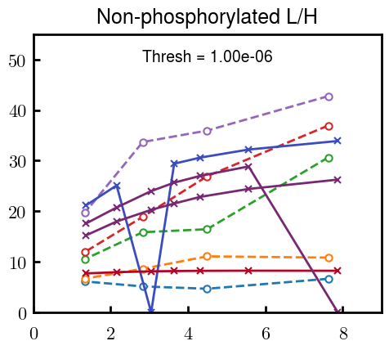


Slide 10
L/H Fitting

Slide 11


Continuation from prev params

Slide 12








Try similar params to H
5.6
11.2
16.8
28
56
7.5
11.25
18.75

Slide 13


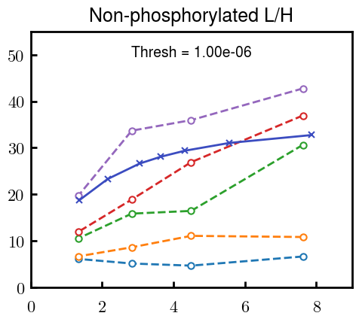
Try similar params to H, b change
15.6
23.4
31.2

Slide 14







v2.7 and some fine
b1.50 v2.7 c3.2
b1.75 v2.7 c3.2
b1.75 v2.5 c3.2
b1.75 v2.5 c3.0
b2.0 v2.7 c3.2
b2.25 v2.7 c3.2
b2.50 v2.7 c3.2
Phi too small to decrease v0

Slide 15










b2.0 v10.0 c3.0
b2.0 v8.0 c3.0
b2.0 v6.0 c3.0
b2.0 v4.0 c3.0
b2.0 v2.0 c3.0
Phi limit
b1.8 v10.0 c3.0
b1.8 v8.0 c3.0
b1.8 v6.0 c3.0
b1.8 v3.0 c3.0
b1.8 v2.0 c3.0
Phi limit

Slide 16





b1.6 v10.0 c3.0
b1.6 v8.0 c3.0
b1.6 v6.0 c3.0
b1.6 v2.0 c3.0
b1.6 v1.5 c3.0
Phi limit

Slide 17


Response to stimuli given composition
Same data
Effect of composition given environment

Slide 18


NFL, pH 7.44, phos 1.5e (locs from LCMS)
Non-phos NFL
Block number | Alpha w/ Henderson Hasselbalch | Chi Chi_max = 3.2
[0 50] | 0.040012 | 1.540000
[50 75] | -0.278451 | 0.960000
[75 125] | -0.519707 | 0.868000
[125 156] | -0.154453 | 0.690323
 | Slope Bins 4 | Smear Count 25
Block number | Alpha w/ Henderson Hasselbalch | Chi Chi_max = 3.2
[0 50] | -0.019988 | 1.540000
[50 75] | -0.278451 | 0.960000
[75 125] | -0.519707 | 0.868000
[125 156] | -0.154453 | 0.690323

Slide 19


NFH, pH 7.44, phos 1.5e (locs from LCMS)
 | Slope Bins 4 | Smear Count 36
Block number | Alpha w/ Henderson Hasselbalch | Chi Chi_max = 3.2 | Chi Chi_max = 3.0
[0 36] | 0.000945 | 1.266667 | 1.20000
[36 72] | -0.527455 | 0.900000 | 0.85000
[72 324] | -0.208376 | 1.729365 | 1.628571
[324 396] | -0.111195 | 1.416667 | 1.333333
[396 432] | -0.152824 | 1.344444 | 1.266667
[432 647] | -0.033955 | 1.077209 | 1.015814

Slide 20

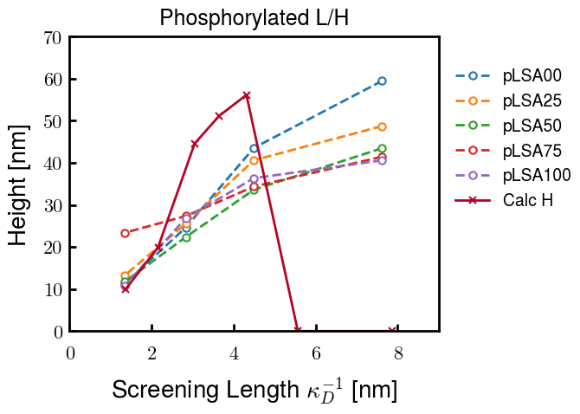
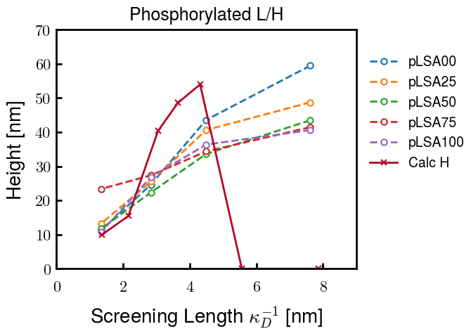
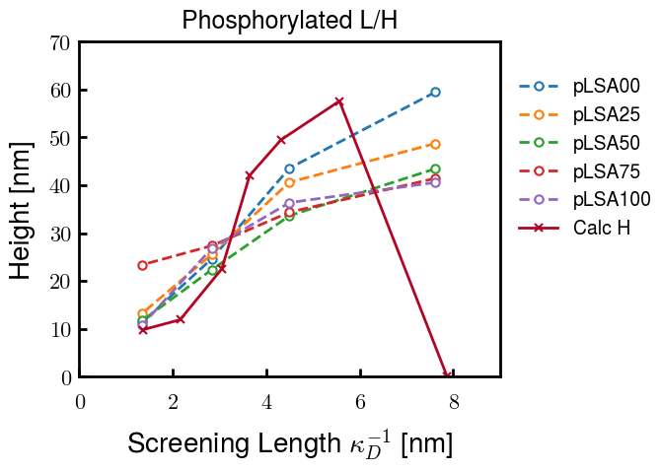
Instead of fitting b/v, could just change value of charge on phos. Try both and see if makes difference for mixture

Slide 21









b2.0 v2.7 c3.2
b3.0 v3.5 c3.5
b3.0 v7.0 c3.5
b3.0 v7.0 c3.0
Phi too small
Phi too small to decrease v0
b4.0 v12.0 c3.0
b5.0 v20.0 c3.0
b5.0 v20.0 c4.0
b5.0 v5.0 c3.0
b5.0 v10.0 c3.0
Phi too small to decrease v0

Slide 22





v20
b5.0 v20.0 c3.0
b4.5 v20.0 c3.0
b4.0 v20.0 c3.0
b3.5 v20.0 c3.0
v10
b5.0 v10.0 c3.0
b4.0 v10.0 c3.0
b3.0 v10.0 c3.0
b2.0 v10.0 c3.0

Slide 23




b2.00 v2.70 c3.20
b2.00 v2.75 c3.20

Slide 24
NFH fitting (from NFL best fit)

Slide 25








b1.00, v0.50, c3.2
b2.00, v4.00, c3.2, th2.5e-02
b1.00, v2.00, c3.2
b1.00, v1.00, c3.2

Slide 26
Mixture

Slide 27



Slide 28


b = 0.75

Slide 29





Slide 30
b = 1.0

Slide 31





Slide 32
b = 1.25

Slide 33




Chi 2.6
Bad vol frac

Slide 34








b25v0
b25v1
b25v2
b25v3

Slide 35




Chi 2.8
Bad vol frac

Slide 36





Slide 37
b = 1.50

Slide 38






Chi 2.8
Bad vol frac

Slide 39





Slide 40

b = 2.00
v4 = 0.25*b^3

Slide 41


Bad vol frac

Slide 42



Slide 43
Fine tune

Slide 44



b1.25, v1.95, c3.0
b1.50, v3.38, c3.0
b2.00, v4.00, c3.0
Norm seems to capture kinked behavior

Slide 45




Slide 46



b1.25, v1.95, c3.2
b1.50, v3.38, c3.2
b2.00, v4.00, c3.2

Slide 47




Slide 48


b1.25
b1.50
b2.00
c2.8
c3.0
c3.2

